Slide 1
CNN’s Family

Slide 2
AlexNet (2012)
Won the ImageNet competition in 2012, popularizing deep learning.
Five convolutional layers followed by three fully connected layers, introduced ReLU activation for faster training.
Used dropout for regularization.
Trained on GPUs for the first time.

Slide 3
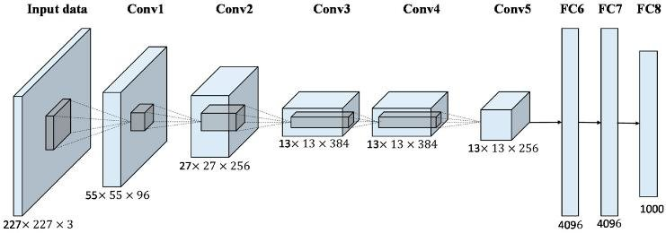
AlexNet Architecture

Slide 4
VGGNet (2014)
Developed by the Visual Geometry Group at Oxford.
Used small 3x3 filters throughout the network.
Came in two variants: VGG-16 and VGG-19 (16 and 19 layers, respectively).
Showed that depth improves performance.

Slide 5
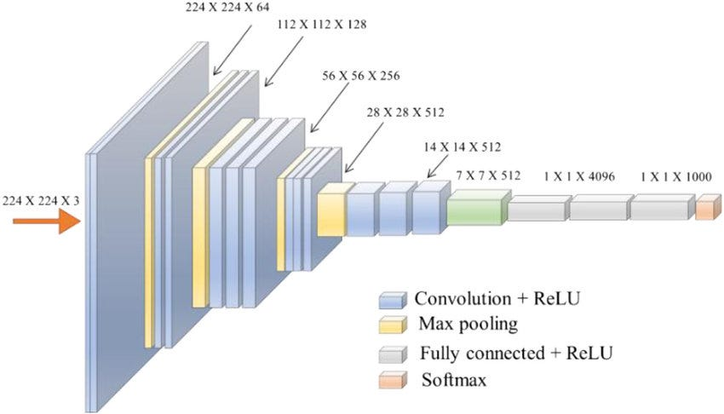
VGGNet Architecture
https://ai.plainenglish.io/vggnet-with-tensorflow-transfer-learning-with-vgg16-included-7e5f6fa9479a

Slide 6
ResNet (2015)
Introduced residual connections to enable training of very deep networks
Used skip connections to bypass layers, addressing the vanishing gradient problem.
Came in variants like ResNet-50, ResNet-101, and ResNet-152.
Won the ImageNet competition in 2015 with a top-5 error rate of 3.57%

Slide 7
Advanced Architectures
MobileNet
ShuffleNet
NASNet
Transformer-based Vision Models.

Slide 8
Data Augmentation

Slide 9
What is Data Augmentation
Data augmentation is a technique used to artificially increase the size and diversity of a training dataset by applying various transformations to the existing data.
It helps improve the generalization of machine learning models, especially in scenarios where labeled data is scarce.

Slide 10
Why is it important
Prevents overfitting: The model learns to generalize better than memorizing the training data by introducing variations.
Improves model robustness: The model becomes more invariant to changes in input data (e.g., rotation, scaling, noise).

Slide 11
Data Augmentation Techniques
Geometric Transformations
Color Space Transformations
Noise Injection

Slide 12
Geometric Transformations
Rotation: Rotate the image by a certain angle (e.g., 90°, 180°)
Translation: Shift the image horizontally or vertically.
Scaling: Zoom in or out of the image.
Flipping: Flip the image horizontally or vertically.
Cropping: Randomly crop a portion of the image.

Slide 13
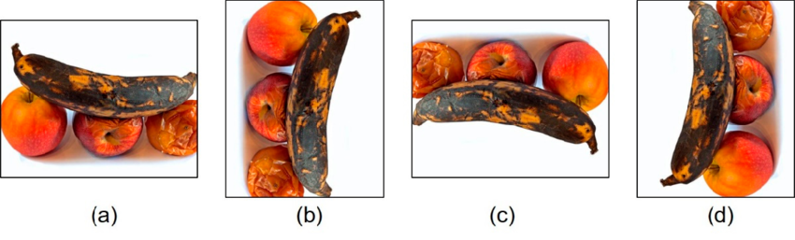
Geometric Transformations
https://www.researchgate.net/publication/364764514_Improved_Classification_Approach_for_Fruits_and_Vegetables_Freshness_Based_on_Deep_Learning/figures?lo=1&utm_source=google&utm_medium=organic

Slide 14
Color Space Transformations
Brightness Adjustment: Increases or decreases the brightness.
Contrast Adjustment: Modify the contrast of the image.
Color Jittering: Randomly change the color balance.
Grayscale Conversion: Convert the image to grayscale.

Slide 15
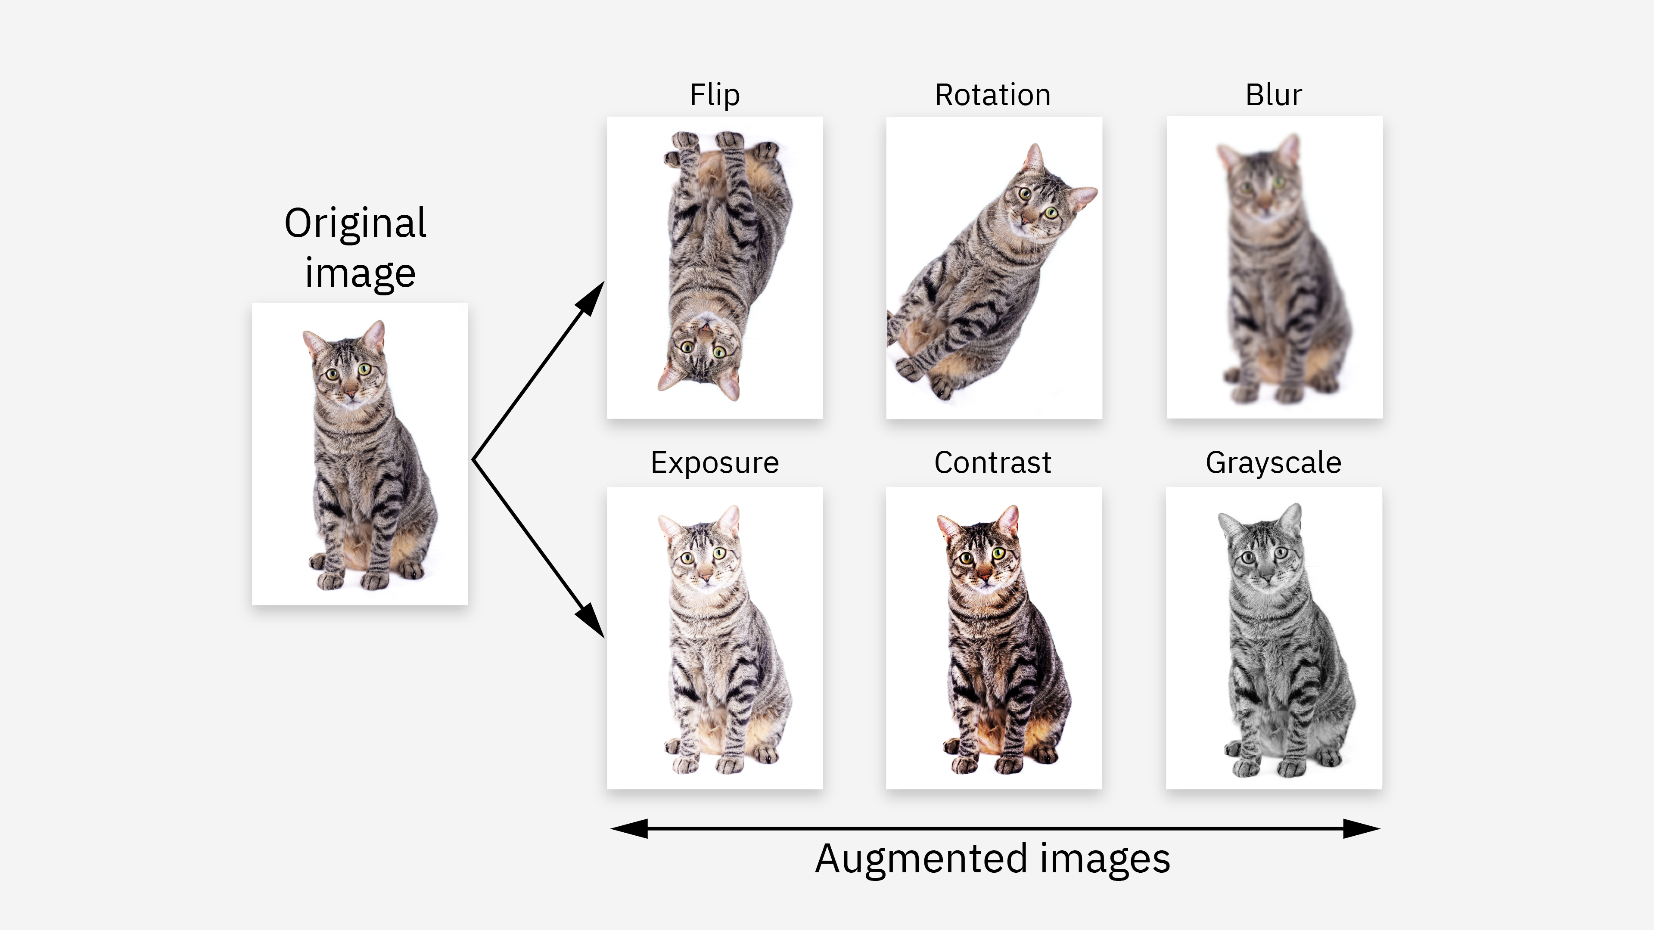
Color Space Transformations
https://www.ibm.com/think/topics/data-augmentation

Slide 16
Noise Injection
Add random noise (e.g., Gaussian noise) to the image to make the model robust to imperfections.

Slide 17
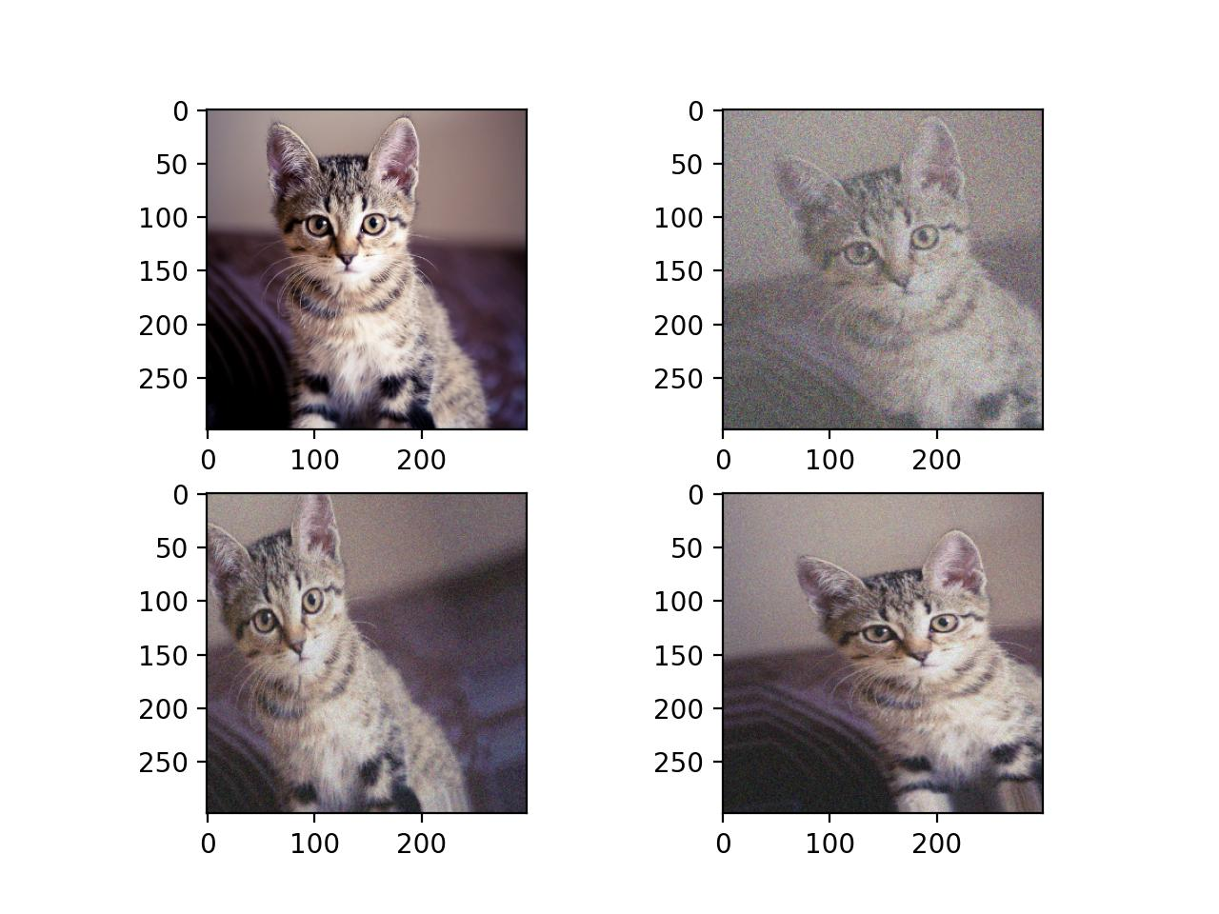
Noise Injection
https://stackoverflow.com/questions/43382045/keras-realtime-augmentation-adding-noise-and-contrast

Slide 18
Best Practices for Data Augmentation
Preserve Label Integrity
Ensure that augmentations don’t change the class label.
For example, rotating a digit ‘6’ by 180° might look like a ‘9’ — this would change its meaning.
✅ Good: Slight tilt (±15°) of Urdu letter ب
❌ Bad: Horizontal flip of Urdu letter پ, which turns it into something else
🔑 Always make sure that the augmented image still belongs to the same class.
2. 🚫 Avoid Over-Augmentation
Too many transformations or extreme changes can confuse the model.
Over-augmentation may introduce unrealistic or unrecognizable data.
❌ Example: Rotating characters by ±90° or applying too much distortion
✅ Use moderate, realistic changes that reflect actual variability in handwriting.
🔑 Balance is key. Too much augmentation can be worse than none.
3. 🌍 Domain-Specific Augmentation
Tailor your augmentations based on your data domain.
For handwritten characters, useful augmentations include:
Small rotation, translation
Elastic distortions (to simulate handwriting variations)
Noise (to simulate pen smudges or scanner noise)
🔑 Use augmentations that make sense for your task — what works for natural images may not work for text or handwriting.

Slide 19
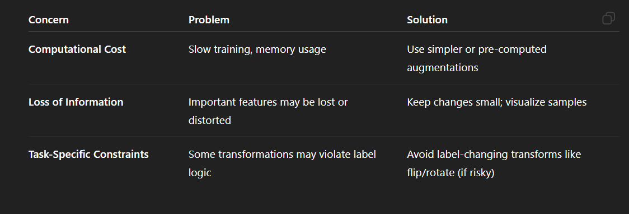
Challenges and Limitations
Computational Cost
Loss of Information
Task-Specific Constraints

Slide 20
Applications of Data Augmentation
Computer Vision: Image classification, object detection, segmentation.
Natural Language Processing: Text classification, machine translation.
Speech Recognition: Improving robustness to noise and accents.
Healthcare: Augmenting medical images for better diagnosis.

